Slide 1

NSP Survey = 36 responses

Slide 2
Yes = 30
No= 6
From where?
Cardiff Prison
Hostels (Huggard)
Boots Pharamcy
CAU
Drug and alcohol services – staff
Friends (word of mouth)

Slide 3
Y = 15
N = 21

Slide 4
Do you think there are any myths about NSP’s?
“IT PROMOTES DRUG USE”
“THAT ITS EXPENSIVE”
“IT ENCOURAGES DRUG TAKING, SOME PEOPLE IMAGINE A CONGREGATION OF USERS IN ONE PLACE
“THEY ARE NOT GIVING OUT CLEAN NEEDLES”
“PEOPLE THAT USE HARD DRUGS WILL USE NEEDLES”
“SOME NEEDLE EXCHANGES GIVE OUT FAULTY EQUIPMENT”
“YOU WILL GET JUDGED FOR WALKING INTO AN NSP”
“ONLY JUNKIES GO THERE”
“NEEDLES ARE TOO READILY AVAILABLE”
“THEY ONLY GIVE OUT NEEDLES”
“NOT ALL NEEDLE EXCHANGES GIVE OUT THE SAME NEEDLES”

Slide 5
What do you think are the best ways of promoting NSP’s?
“WORD OF MOUTH”
“POSTERS IN KEY HOT SPOTS OR AREAS”
“ONLINE”
“ADVERTISING IN LOCAL HUBS”
“WELL TRAINED STAFF WHO CAN ENCOURAGE SERVICE USERS”
“MORE PROMOTION ON THE HARM REDUCTION VAN”
“GOING TO MORE HOSTELS TO PROMOTE NSP’s”
“PROMOTING INCENTIVES FOR BRINGING USED NEEDLES BACK”
“HAVE BOXES OF NEEDLES DISPLAYED IN THE RECEPTION OF HOSTELS
“MORE POSTERS IN PHARMACIES
“CHALLENGE STIGMA AND MYTHS”
“OFFER TRAINING AROUND DANGERS TO BBV AND NEEDLE STICK INJURIES”
“AN APP OF AVAILABLE PHARMACIES OR HOSTELS IN CARDIFF AND VALE”

Slide 6
Yes = 18
No= 18

Slide 7
Do you have any worries regarding needle use in your accommodation?
“WAY TOO MUCH NEEDLE SHARING”
“SOME NEEDLE USERS ARE NOT KEEPING THEIR AREA CLEAN, IT’S NOT FAIR ON OTHERS”
“NOT ENOUGH HARM REDUCTION OR WOUND CARE ADVICE”
“SOME PEOPLE ARE NOT USING SHARP BINS EVEN THOUGH IF THEY ARE A NEEDLE USER”
“A KID MIGHT FIND ONE, TOUCH OR PICK IT UP”
“INCORRECT PARAPHERNALIA AND DISPOSAL”
“SOME NEEDLE USERS ARE USING IN FRONT OF RECOVERING ADDICTS”
“SERVICES NOT COMMUNICATING WHERE USED NEEDLES CAN BE COLLECTED”
“I’M AFRAID TO STEP ON THEM, THERE’S A FEW LAYING AROUND IN PEOPLE’S ROOM”
“I HAVE TO BE CAREFUL IN TOILETS AND SHOWERS BECAUSE I FIND NEEDLES THERE SOMETIMES

Slide 8
Yes = 29
No = 7

Slide 9
Have you seen anyone dispose of their sharps in a different way (i.e. other than a sharps bin)
“IN BEER CANS”
“IN NORMAL BINS, NOT A SHARPS BIN”
“IN A HOLE OF A BRICK WALL”
“IN THE TOILET”
“IN PEOPLE’S FLAT, JUST LAYING ON THE FLOOR”
“SANITARY BINS”
“IN CERTAIN HOTSPOTS – ADAMSDOWN, SPLOTT, CLIFTON STREET, BROADWAY, SOPHIA GARDENS”
“NEAR BUS STOPS”
“UNDERNEATH THE TRAIN BRIDGE”
“PUBLIC BATHROOMS”
“IN THE CITY CENTRE”
“IN BUSHES”
“STREET LANES”
“IN COMMUNAL AREAS”
“OUTSIDE MY HOSTEL ENTRANCE”
“DOWN DRAINS”
“OUTSIDE MY CORRIDOR”
“IN A WASHING MACHINE”

Slide 10
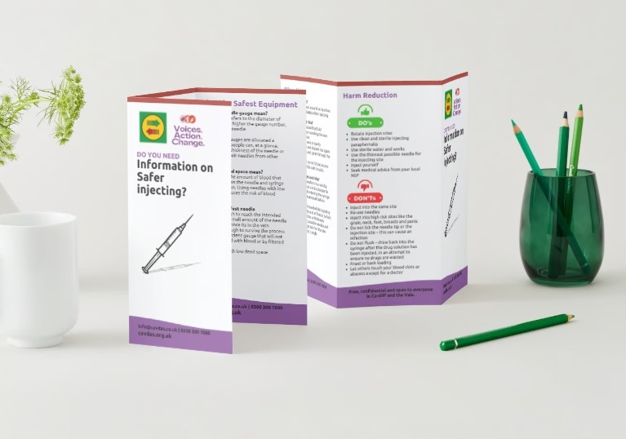
VAC Rep Suggestions
More promotion of single black sharps bin for needle disposal
Deliver NSP training to hostels/harm reduction peers/vac reps so they feel confident in knowledge and safer injecting
Create posters for sharps bins to encourage harm reduction
More Harm Reduction/Naloxone Training for SU with incentives/certificates included (something they can look forward to)
Resources shared i.e. safer injecting leaflet, WEDINOS, Harm Reduction Hub Info sheet

